Slide 1
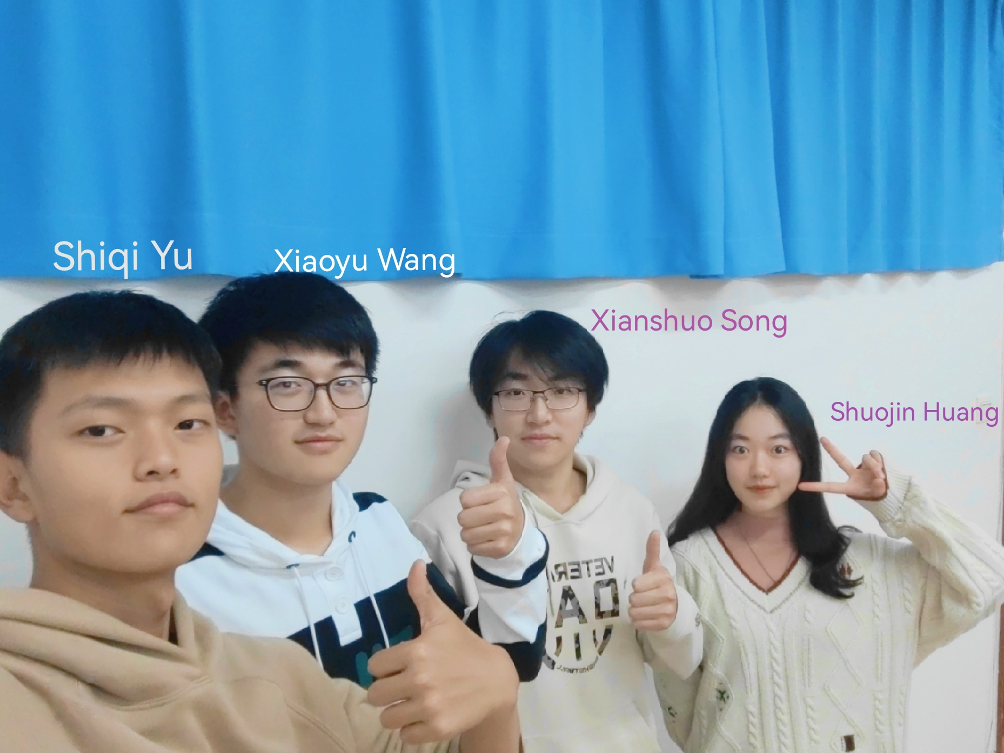
Group 19

Slide 2
Thanks for listening
Group 19

